Slide 1


Creating a Blazor WebAssembly powered e-commerce website
(part 1)

Slide 2
WebAssembly
Builds upon asm.js and Google Native Client
A compilation target for high-level languages
Supported by all major browsers
Runs in a memory-safe, sandboxed environment
A binary instruction format for a stack-based virtual machine supporting modules, functions, tables, linear memory and global variables
Has four value types 32-bit and 64-bit integers and 32-bit and 64-bit floating point numbers

Slide 3
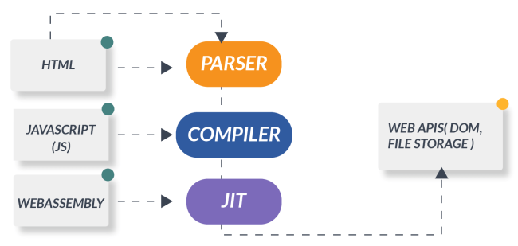
WebAssembly

Slide 4
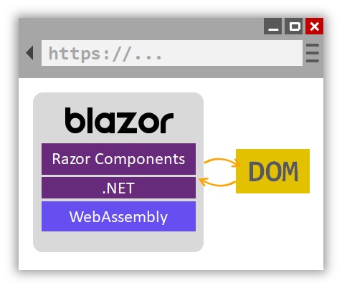
Blazor WebAssembly
Build single-page applications
Razor component-based architecture
Write code in C# instead of JavaScript

Slide 5
What this presentation will cover
Setup of Blazor WebAssembly solution
Create a set of basic static Blazor components (Index, Category, Product) from an e-commerce website template
Creating a database to support basic e-commerce website functionality
Creating an API for the Blazor components to communicate with to retrieve and store data
Making the Blazor components dynamic and extracting smaller components out
Key Blazor technology demonstrations: data binding, component state changes, Blazor CSS isolation and using JS Interop
Built using a combination of VSCode and command line

Slide 6
Development Notes
Github repo: https://github.com/gras1/BlazorCommercePart1
Install the .NET 5 SDK
VSCode Extensions/Plugins used:
  .NET Install Tool for Extension Authors
  C#
  C# Extensions
  HTML CSS Support
  Microsoft.AspNetCore.Razor.VSCode.BlazorWasmDebuggingExtension
  NuGet Package Manager
  Visual Studio IntelliCode
  Visual Studio Keymap
  WebAssembly

